Slide 1
Audio Playground Dashboard
Workshop
Updated 03-06-2022
By: Diane Zievinger
Notes:
Audio Playground is a web application that enables researchers to transcribe audio to text and analyze audio and text

Slide 2
Agenda
1
2
3
General Overview of the Tool
Directions and Advice
BMS Contact Info

Slide 3
1. Audio Playground – What?
Web application developed by the BMS Lab that provides an accessible manner to transcribe auto to text and analyze audio and text.
1.
Notes:
If you want to delete the task, on the top left side select the task.
and click the “delete” button.
This will delete all the task information, except for your uploaded audio.
These instructions are also relevant for Audio Analysis and Text Analysis. But, as the Audio Analysis and the Text Analysis is a work in progress, limited statistics are shown in the development version.

Slide 4
1. Audio Playground – Why?
Support UT researchers and students
Created especially for long recorded interviews and group conversations
Three audio analysis methods within one dashboard
2.
Notes:
If you want to delete the task, on the top left side select the task.
and click the “delete” button.
This will delete all the task information, except for your uploaded audio.
These instructions are also relevant for Audio Analysis and Text Analysis. But, as the Audio Analysis and the Text Analysis is a work in progress, limited statistics are shown in the development version.

Slide 5
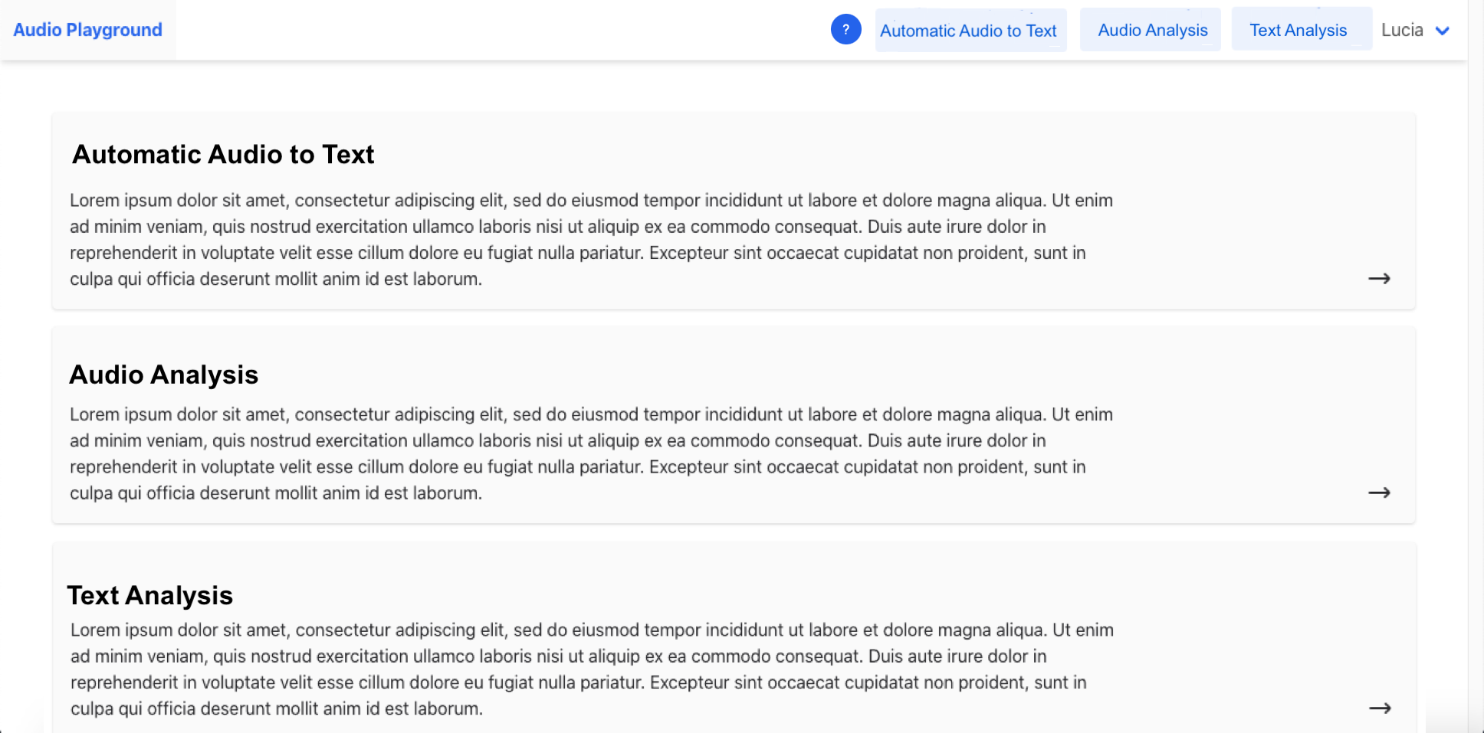
1. Dashboard Example
1
2
3
3.
Notes:
Audio Playground is a web application that enables researchers to edit and analyze audio and text using three methods: (1) Automatic Audio to Text, (2) Audio Analysis, and (3) Text Analysis.

Slide 6
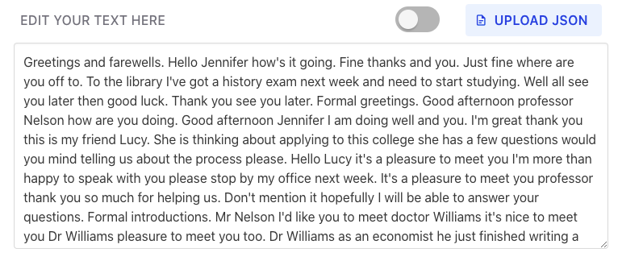
1.1 Automatic Audio to Text
Results
Transcribed Audio
4.

Slide 7
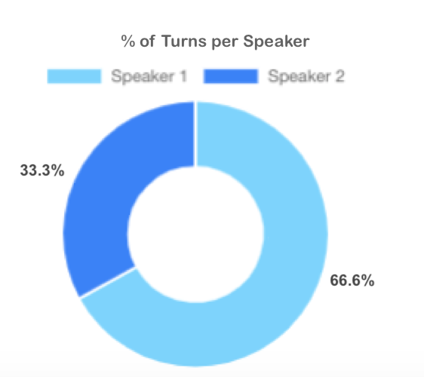
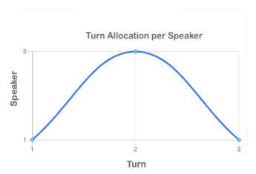
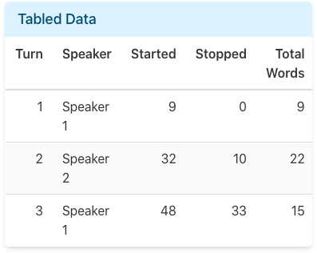
1.2 Audio Analysis
Statistics
Data Overview
Data Classification
Total Words per Turn and Speaker
Turn Allocation per Speaker
% of Turns per Speaker
Audio Coding
5.

Slide 8
1.3 Text Analysis
Statistics
Data Overview
Data Classification
Total Words per Turn and Speaker
Turn Allocation per Speaker
% of Turns per Speaker
Sentiment Analysis
Emotion Analysis
6.

Slide 9
1.3 Text Analysis – Analysis of Sentiment ¹ ²
General: Full document
Specific: Entities and Keywords
Sentiment Score = overall sentiment leaning of the text.
Positive Score = 1.0
Negative Score = -1.0
Neutral Score = 0.0
7.
Notes:
Analyze sentiment for the whole document, entities (=nouns, e.g., specific people, places, etc.) and keywords (=describes the content).
References:
¹ https://cloud.ibm.com/apidocs/natural-language-understanding?code=java#sentiment
^{2.} https://www.ibm.com/blogs/watson/2020/08/solving-common-challenges-in-sentiment-analysis-with-help-from-project-debater/

Slide 10
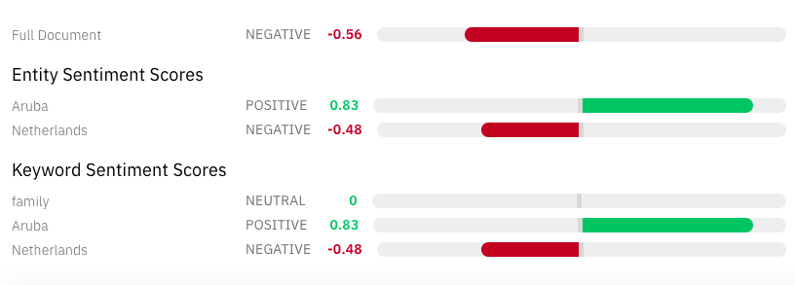
1.3 Text Analysis – Analysis of Sentiment Example
8.
Notes:
Reference:
https://www.ibm.com/demos/live/natural-language-understanding/self-service/home

Slide 11
1.3 Text Analysis – Analysis of Emotion ¹
General: Full document
Specific: Entities and Keywords
Emotion Score = overall emotional leaning of the text.
Sad
Happy
Fear
Disgust
Anger
9.
Notes:
Analyze emotion for the whole document, entities (=nouns, e.g., specific people, places, etc.) and keywords (=describes the content).
Reference:
¹ https://cloud.ibm.com/apidocs/natural-language-understanding#emotion

Slide 12
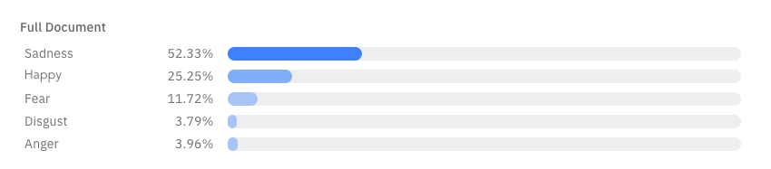
1.3 Text Analysis – Analysis of Emotion Example
10.
Notes:
Reference:
https://www.ibm.com/demos/live/natural-language-understanding/self-service/home

Slide 13
1.3 Text Analysis – Analysis of Emotion Example
11.
Notes:
Reference:
https://www.ibm.com/demos/live/natural-language-understanding/self-service/home

Slide 14
1.3 Text Analysis – Natural Language Relevance Training
Confidence score = 0.0 – 1.0
The higher the score, the more relevant the result
12.
Notes:
For more info see: https://cloud.ibm.com/docs/discovery-data?topic=discovery-data-train

Slide 15
2. Audio Playground Test
Under Development:
Automatic Audio to Text (named STT)
Audio Analysis (named Coder)
Text Analysis (named Transcription)
Disclaimer: Currently, the development version shows a more or less complete result for Automatic Audio to Text. However, the Audio Analysis and Text Analysis is a work in progress and thus shows limited statistics.
13.
Notes:
The Audio Playground Dashboard for all three methods are under development but the idea is for it to look like how we showed earlier (slide 1-10).
The next slides will only go into the “Automatic Audio to Text” as it shows a more or less complete result.

Slide 16
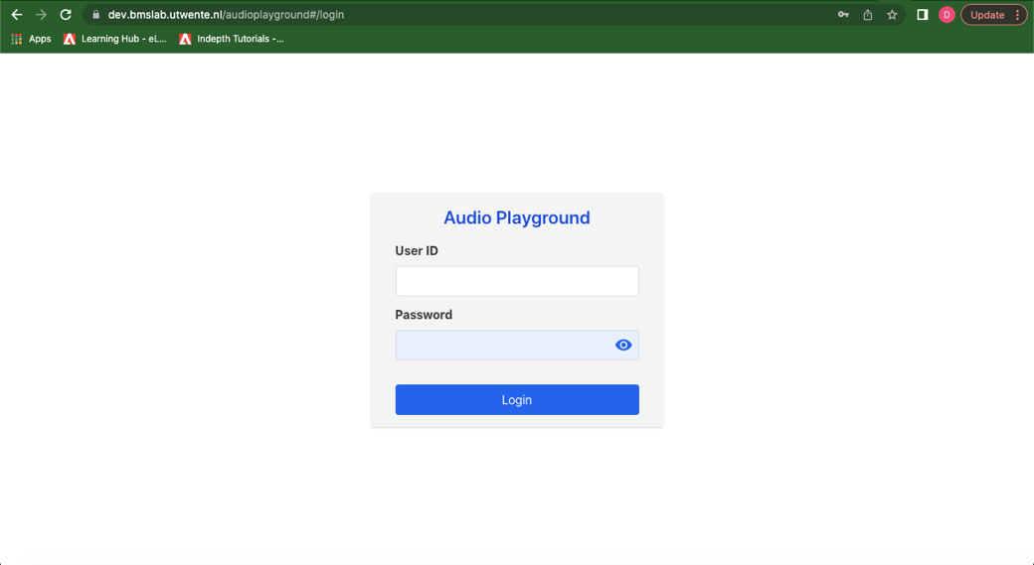
2. Audio Playground Test
Disclaimer: User ID …. is only meant for testing and not for actual research.
14.
Notes:
Audio Playground is a web application that enables researchers to edit and analyze audio and text using three methods: (1) Automatic Audio to Text, (2) Audio Analysis, and (3) Text Analysis.
You can access the Audio Playground by:
Going to https://dev.bmslab.utwente.nl/audioplayground/ - /login
Login with your UT account.
The website’s use is exclusively for UT staff and students. There is a clean copy that you can test (not meant for actual research):
User ID: -
Password: -
Once you have logged in, you will see the Audio Playground’s dashboard. Here, you can choose which method you would like to analyze your audio or text. Either through (1) Automatic Audio to Text, (2) Audio Analysis, and (3) Text Analysis.

Slide 17
2. Test - Automatic Audio to Text (named STT)
Creating a task:
On the left side, enter the task name.
Click on “create”.
Click on the task you have just created.
On the right side, paste the audio to or click “Drag or Click to upload”.
Select the audio file you would like to attach to the task
Click on “Save”(!).
Disclaimer: Instructions on this slide are also relevant for Audio Analysis and Text Analysis.
15.
Notes:
If you want to delete the task, on the top left side select the task.
and click the “delete” button.
This will delete all the task information, except for your uploaded audio.
These instructions are also relevant for Audio Analysis and Text Analysis. But, as the Audio Analysis and the Text Analysis is a work in progress, limited statistics are shown in the development version.

Slide 18
2. Test - Automatic Audio to Text (named STT)
Transcribing an audio:
Under the “Text Editor”, you will see the audio.
Here you can play or pause your audio.
And download your audio or edit the playback speed of the audio.
To transcribe the audio, click “convert”.
16.
Notes:
4. Wait time for the conversion of the audio file to text process should be approximately equal to the length in time of the audio file. For example, 7-second file would take around 14 seconds to convert, so you would wait 14 seconds after converting.
You can refresh the page or go to the dashboard and click on the Automatic Audio to Text again.
You have now transcribed your audio.

Slide 19
Thanks!
Do you have any questions? bmslab@utwente.nl Cubicus Building Room B205
bmslab.utwente.nl

